Slide 1

UNIVERSITY CASE STUDY USING SQL
by Antony Raj Victor

Slide 2
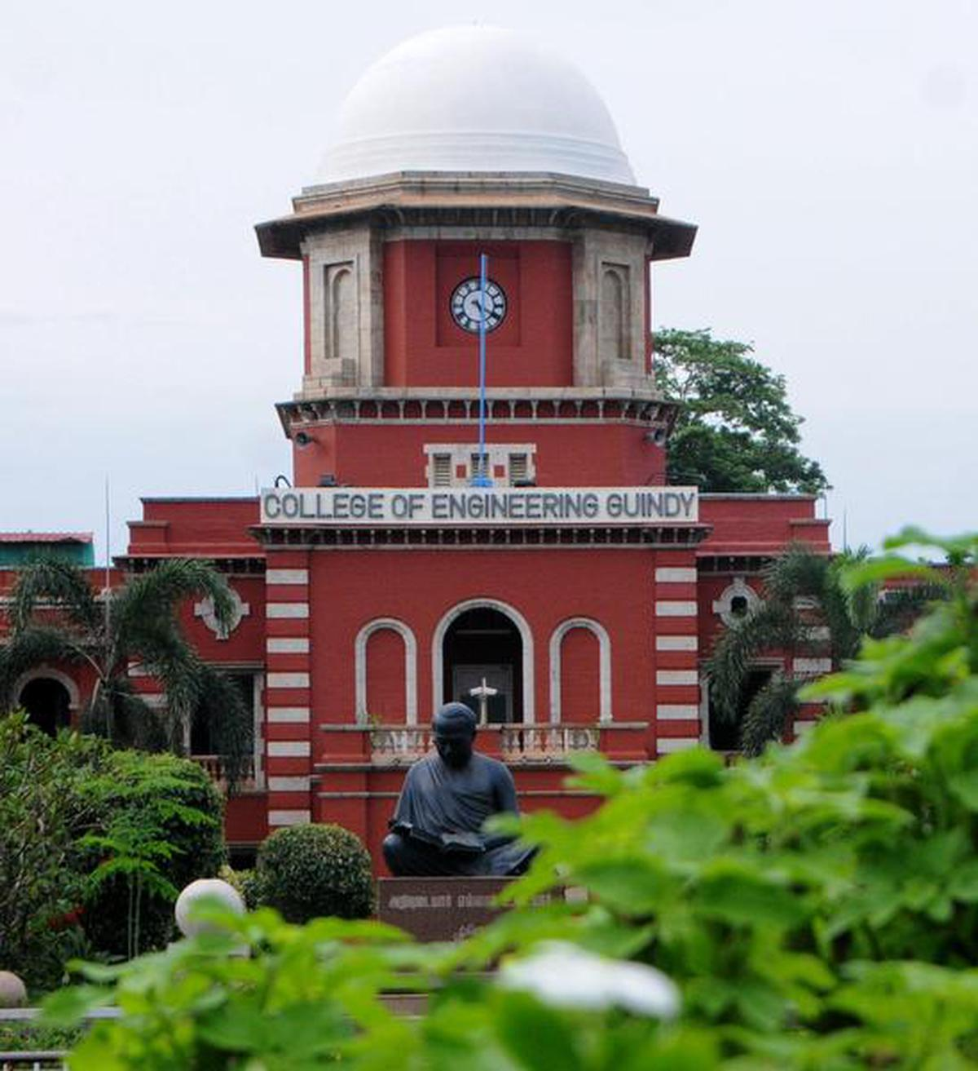
OVERVIEW
The case study consists of 11 University tables.
The tables provide information of students, instructors, course, section, time slot etc.
The goal of this case study is to assist the institution in increasing its growth and efficiency.
This case study includes SQL queries ranging from basic to complex.

Slide 3
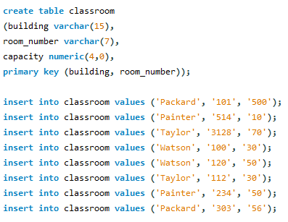
Classroom table
building | room_number | capacity
Packard | 101 | 500
Packard | 303 | 56
Painter | 234 | 50
Painter | 514 | 10
Taylor | 112 | 30
Taylor | 3128 | 70
Watson | 100 | 30
Watson | 120 | 50

Slide 4
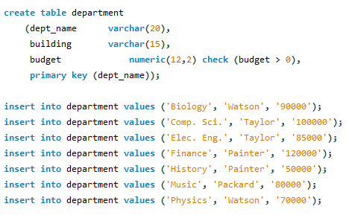
Department table
dept_name | building | budget
Biology | Watson | 91000
Comp. Sci. | Taylor | 101000
Elec. Eng. | Taylor | 86000
Finance | Painter | 121000
History | Painter | 51000
Music | Packard | 81000
Physics | Watson | 71000

Slide 5
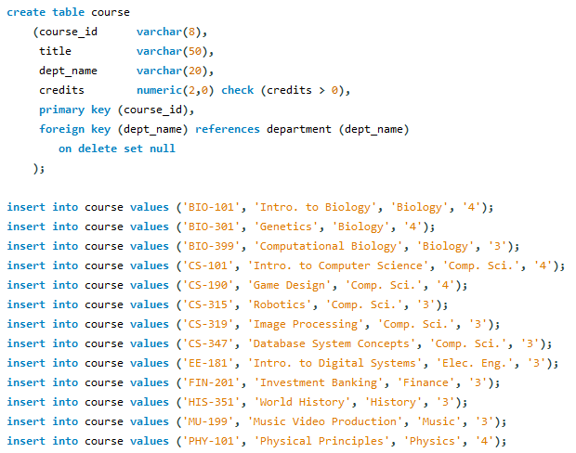
Course table
course_id | title | dept_name | credits
BIO-101 | Intro. to Biology | Biology | 4
BIO-301 | Genetics | Biology | 4
BIO-399 | Computational Biology | Biology | 3
CS-101 | Intro. to Computer Science | Comp. Sci. | 4
CS-190 | Game Design | Comp. Sci. | 4
CS-315 | Robotics | Comp. Sci. | 3
CS-319 | Image Processing | Comp. Sci. | 3
CS-347 | Database System Concepts | Comp. Sci. | 3
EE-181 | Intro. to Digital Systems | Elec. Eng. | 3
FIN-201 | Investment Banking | Finance | 3
HIS-351 | World History | History | 3
MU-199 | Music Video Production | Music | 3
PHY-101 | Physical Principles | Physics | 4

Slide 6
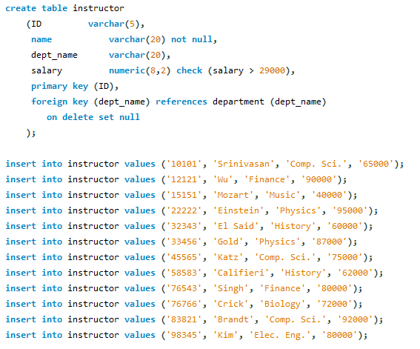
Instructor table
ID | name | dept_name | salary
10101 | Srinivasan | Comp. Sci. | 71500
12121 | Wu | Finance | 99000
15151 | Mozart | Music | 44000
22222 | Einstein | Physics | 95000
32343 | El Said | History | 66000
33456 | Gold | Physics | 95700
45565 | Katz | Comp. Sci. | 82500
58583 | Califieri | History | 68200
76543 | Singh | Finance | 88000
76766 | Crick | Biology | 79200
83821 | Brandt | Comp. Sci. | 92000
98345 | Kim | Elec. Eng. | 88000

Slide 7
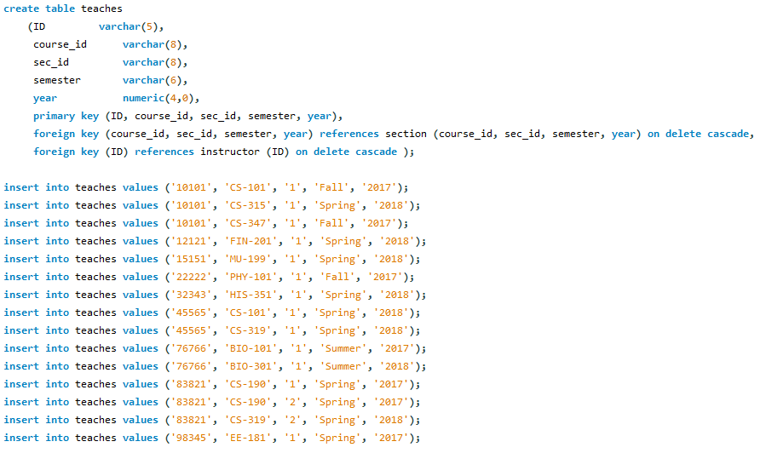
Teaches table

Slide 8
Teaches table
ID | course_id | sec_id | semester | year
76766 | BIO-101 | 1 | Summer | 2017
76766 | BIO-301 | 1 | Summer | 2018
10101 | CS-101 | 1 | Fall | 2017
45565 | CS-101 | 1 | Spring | 2018
83821 | CS-190 | 1 | Spring | 2017
83821 | CS-190 | 2 | Spring | 2017
10101 | CS-315 | 1 | Spring | 2018
45565 | CS-319 | 1 | Spring | 2018
83821 | CS-319 | 2 | Spring | 2018
10101 | CS-347 | 1 | Fall | 2017
98345 | EE-181 | 1 | Spring | 2017
12121 | FIN-201 | 1 | Spring | 2018
32343 | HIS-351 | 1 | Spring | 2018
15151 | MU-199 | 1 | Spring | 2018
22222 | PHY-101 | 1 | Fall | 2017

Slide 9
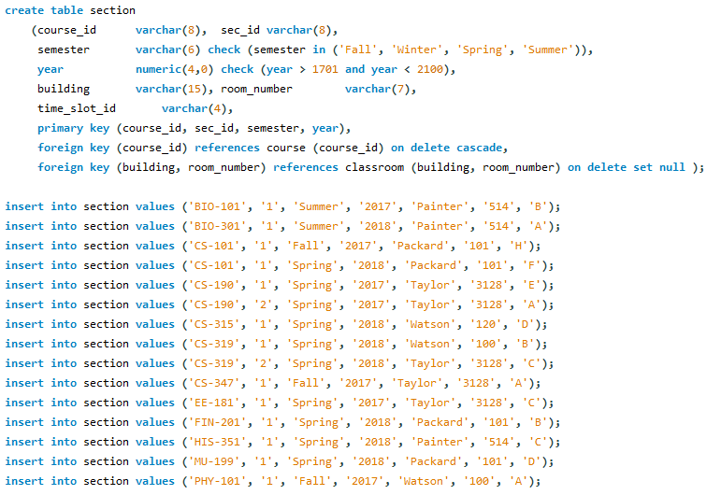
Section table

Slide 10
Section table
course_id | sec_id | semester | year | building | room_number | time_slot_id
BIO-101 | 1 | Summer | 2017 | Painter | 514 | B
BIO-301 | 1 | Summer | 2018 | Painter | 514 | A
CS-101 | 1 | Fall | 2017 | Packard | 101 | H
CS-101 | 1 | Spring | 2018 | Packard | 101 | F
CS-190 | 1 | Spring | 2017 | Taylor | 3128 | E
CS-190 | 2 | Spring | 2017 | Taylor | 3128 | A
CS-315 | 1 | Spring | 2018 | Watson | 120 | D
CS-319 | 1 | Spring | 2018 | Watson | 100 | B
CS-319 | 2 | Spring | 2018 | Taylor | 3128 | C
CS-347 | 1 | Fall | 2017 | Taylor | 3128 | A
EE-181 | 1 | Spring | 2017 | Taylor | 3128 | C
FIN-201 | 1 | Spring | 2018 | Packard | 101 | B
HIS-351 | 1 | Spring | 2018 | Painter | 514 | C
MU-199 | 1 | Spring | 2018 | Packard | 101 | D
PHY-101 | 1 | Fall | 2017 | Watson | 100 | A

Slide 11
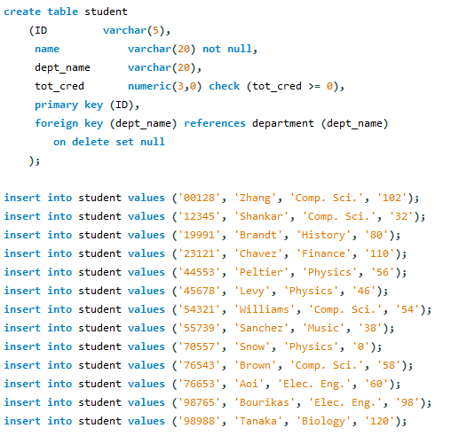
Student table
ID | name | dept_name | tot_cred
128 | Zhang | Comp. Sci. | 102
12345 | Shankar | Comp. Sci. | 32
19991 | Brandt | History | 80
23121 | Chavez | Finance | 110
44553 | Peltier | Physics | 56
45678 | Levy | Physics | 46
54321 | Williams | Comp. Sci. | 54
55739 | Sanchez | Music | 38
70557 | Snow | Physics | 0
76543 | Brown | Comp. Sci. | 58
76653 | Aoi | Elec. Eng. | 60
98765 | Bourikas | Elec. Eng. | 98
98988 | Tanaka | Biology | 120

Slide 12
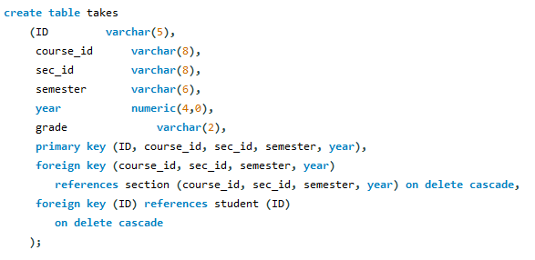
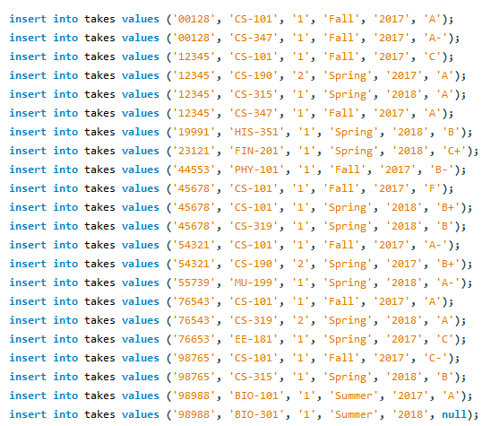
Takes table

Slide 13
Takes table
ID | course_id | sec_id | semester | year | grade
128 | CS-101 | 1 | Fall | 2017 | A
128 | CS-347 | 1 | Fall | 2017 | A-
12345 | CS-101 | 1 | Fall | 2017 | C
12345 | CS-190 | 2 | Spring | 2017 | A
12345 | CS-315 | 1 | Spring | 2018 | A
12345 | CS-347 | 1 | Fall | 2017 | A
19991 | HIS-351 | 1 | Spring | 2018 | B
23121 | FIN-201 | 1 | Spring | 2018 | C+
44553 | PHY-101 | 1 | Fall | 2017 | B-
45678 | CS-101 | 1 | Fall | 2017 | F
45678 | CS-101 | 1 | Spring | 2018 | B+
45678 | CS-319 | 1 | Spring | 2018 | B
54321 | CS-101 | 1 | Fall | 2017 | A-
54321 | CS-190 | 2 | Spring | 2017 | B+
55739 | MU-199 | 1 | Spring | 2018 | A-
76543 | CS-101 | 1 | Fall | 2017 | A
76543 | CS-319 | 2 | Spring | 2018 | A
76653 | EE-181 | 1 | Spring | 2017 | C
98765 | CS-101 | 1 | Fall | 2017 | C-
98765 | CS-315 | 1 | Spring | 2018 | B
98988 | BIO-101 | 1 | Summer | 2017 | A
98988 | BIO-301 | 1 | Summer | 2018 | NULL

Slide 14
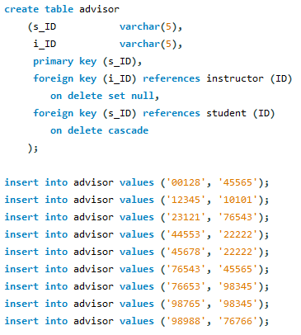
Advisor table
s_ID | i_ID
12345 | 10101
44553 | 22222
45678 | 22222
128 | 45565
76543 | 45565
23121 | 76543
98988 | 76766
76653 | 98345
98765 | 98345

Slide 15
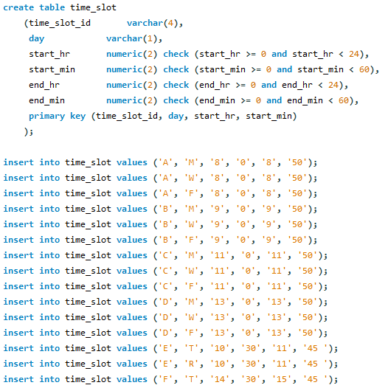
Time_slot table
time_slot_id | day | start_hr | start_min | end_hr | end_min
A | F | 8 | 0 | 8 | 50
A | M | 8 | 0 | 8 | 50
A | W | 8 | 0 | 8 | 50
B | F | 9 | 0 | 9 | 50
B | M | 9 | 0 | 9 | 50
B | W | 9 | 0 | 9 | 50
C | F | 11 | 0 | 11 | 50
C | M | 11 | 0 | 11 | 50
C | W | 11 | 0 | 11 | 50
D | F | 13 | 0 | 13 | 50
D | M | 13 | 0 | 13 | 50
D | W | 13 | 0 | 13 | 50
E | R | 10 | 30 | 11 | 45
E | T | 10 | 30 | 11 | 45
F | R | 14 | 30 | 15 | 45
F | T | 14 | 30 | 15 | 45
G | F | 16 | 0 | 16 | 50
G | M | 16 | 0 | 16 | 50
G | W | 16 | 0 | 16 | 50
H | W | 10 | 0 | 12 | 30

Slide 16
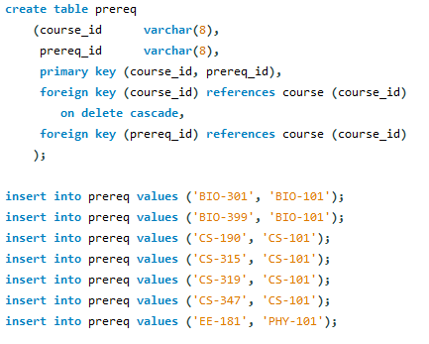
Prerequisite table
course_id | prereq_id
BIO-301 | BIO-101
BIO-399 | BIO-101
CS-190 | CS-101
CS-315 | CS-101
CS-319 | CS-101
CS-347 | CS-101
EE-181 | PHY-101

Slide 17

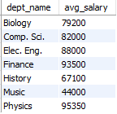
Problem 1
Display average salary given by each department.
Solution:
select dept_name, round(avg(salary)) as avg_salary from instructor
group by dept_name;

Slide 18
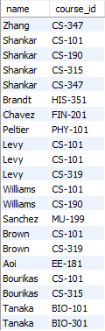
Problem 2
2. Display the name of students and their corresponding course IDs.
Solution:
select name,course_id
from takes,student
where student.id=takes.id;

Slide 19
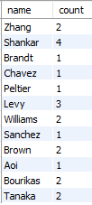
Problem 3
3. Display number of courses taken by each student.
Solution:
select name,count(course_id) as 'count'
from takes,student
where student.id=takes.id
group by name;

Slide 20
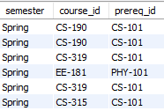
Problem 4
4. Get the prerequisites courses for courses in the Spring semester.
Solution:
select semester,s.course_id,prereq_id
from section s,prereq p
where s.course_id=p.course_id
and semester='spring';

Slide 21
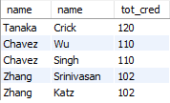
Problem 5
5. Display the instructor name who teaches student with highest 5 credits
Solution:
select s.name,i.name,tot_cred
from student s join instructor i
using (dept_name)
order by tot_cred desc
limit 5;

Slide 22

Problem 6
6. Which semester and department offers maximum number of courses
Solution:
select semester, dept_name, max(count) as max_courses
from
(select semester, dept_name, count(course_id) as count
from course join section using(course_id)
group by dept_name )
as one;

Slide 23

Problem 7
7. Display course and department whose time starts at 8.
Solution:
select distinct course_id,start_hr as hour
from time_slot join section using(time_slot_id)
where start_hr=8;

